Slide 1

MANAGING CONTENT

Slide 2
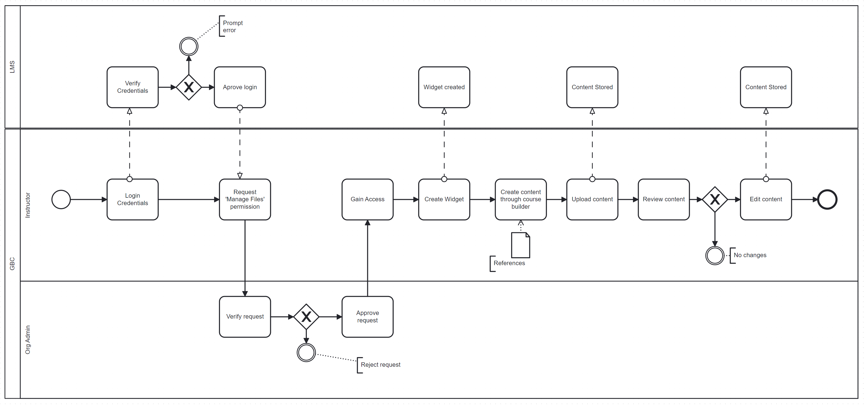
PROCESS MAP – BEFORE ELICITATION

Slide 3
Major changes after Elicitation #2
Included PC / Associate Dean roles
Eliminated Admin role
Further breaking down the process map into atomic levels (create/edit/delete content)
Included decision – Create content from scratch (or) use existing
Included decision – Make content visible to students (or) hide

Slide 4
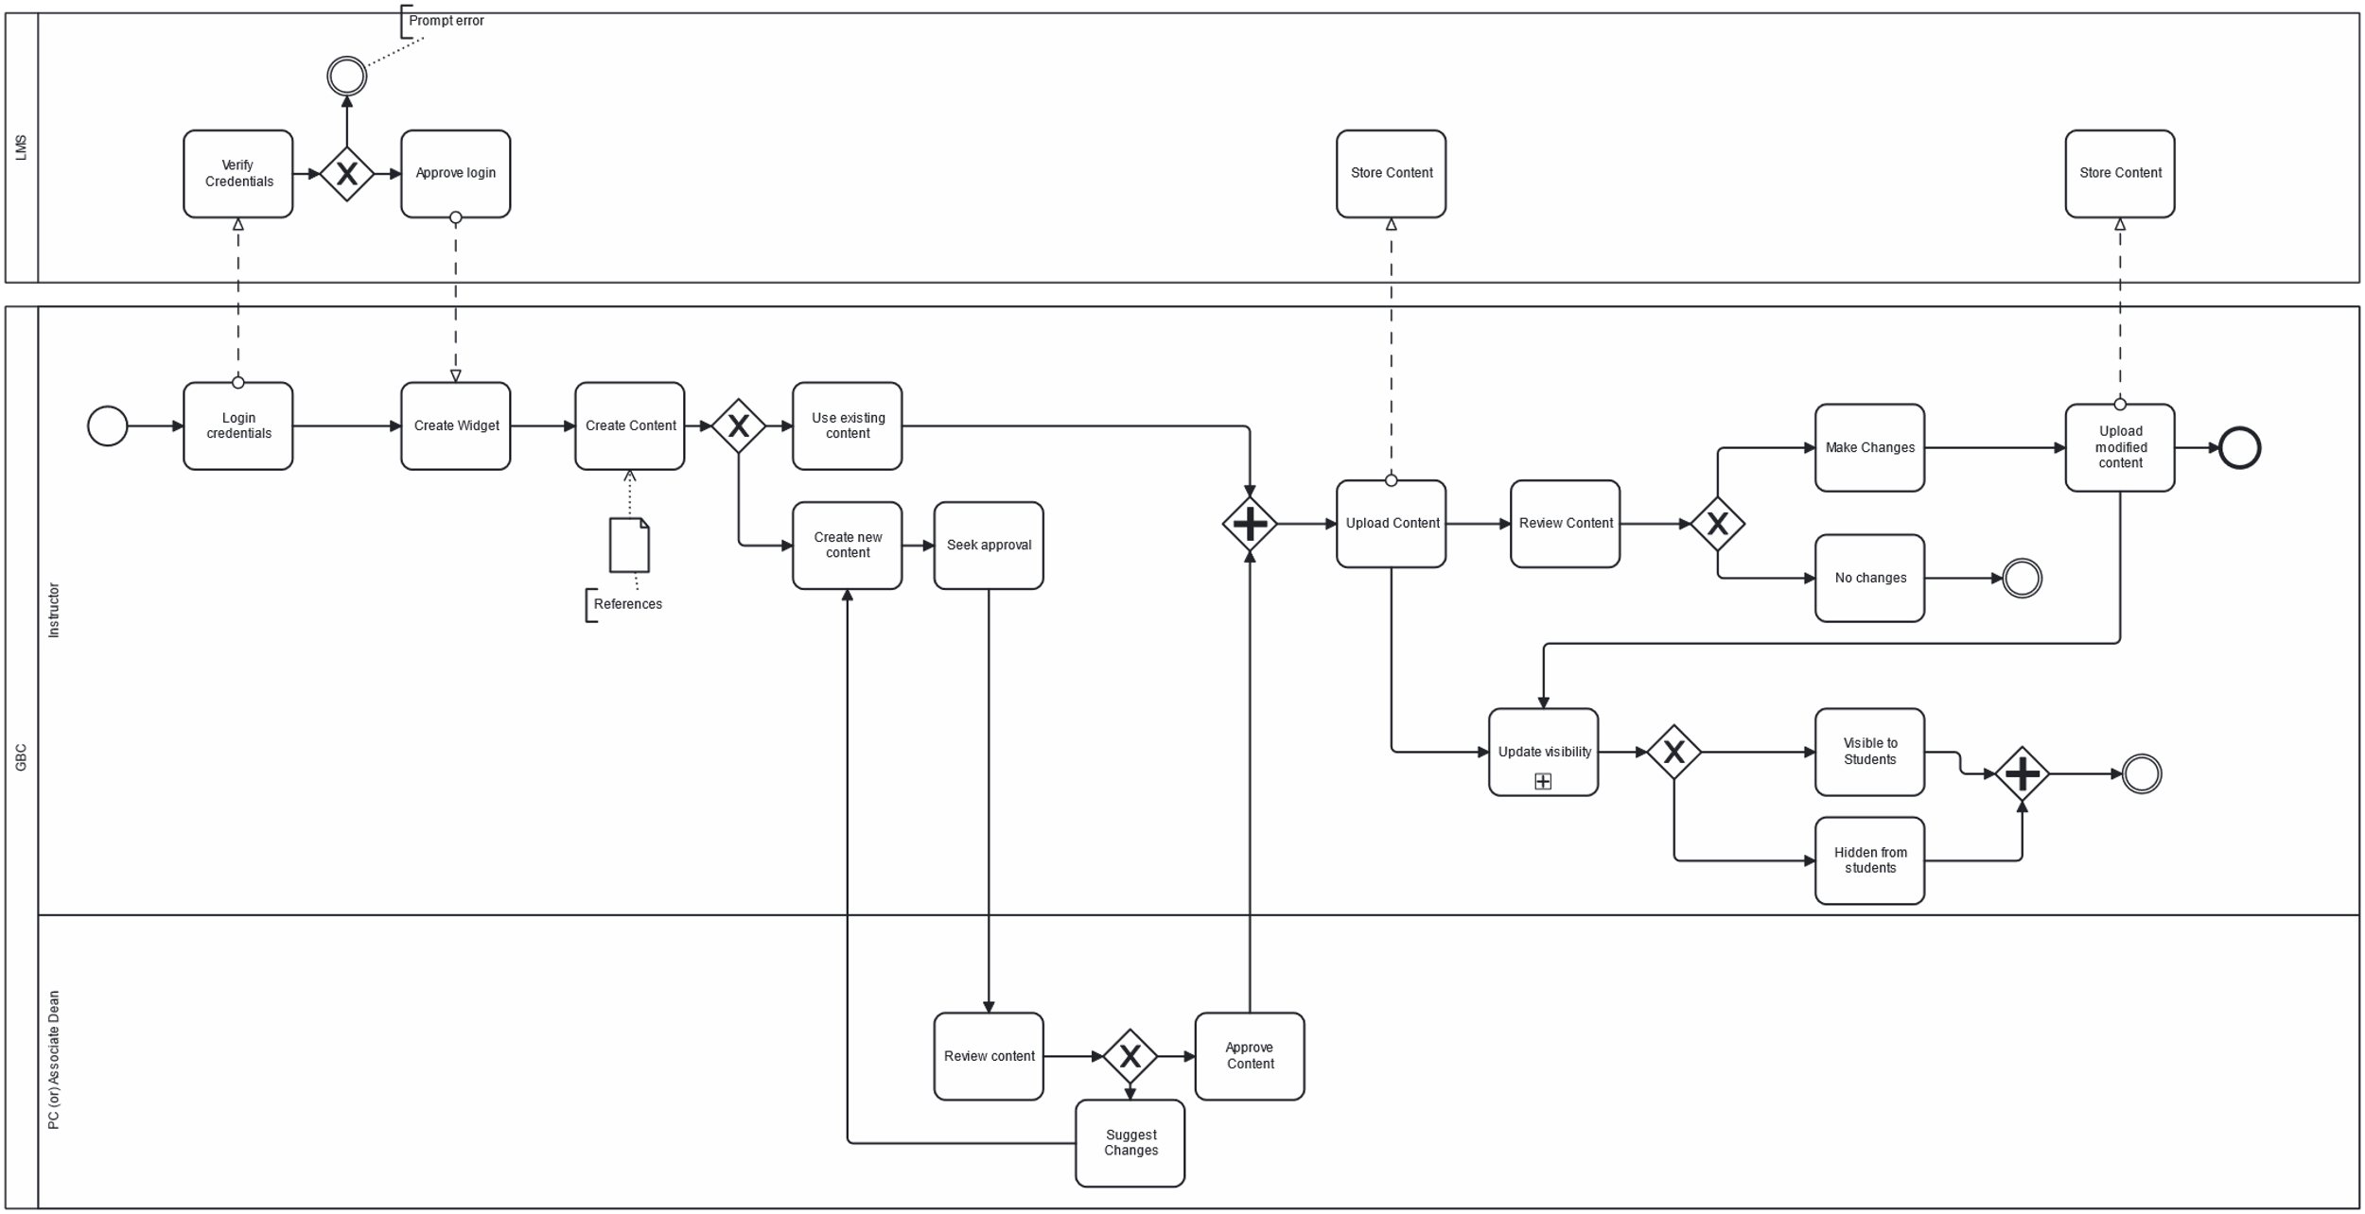
PROCESS MAP (OVERALL) - AFTER ELICITATION

Slide 5
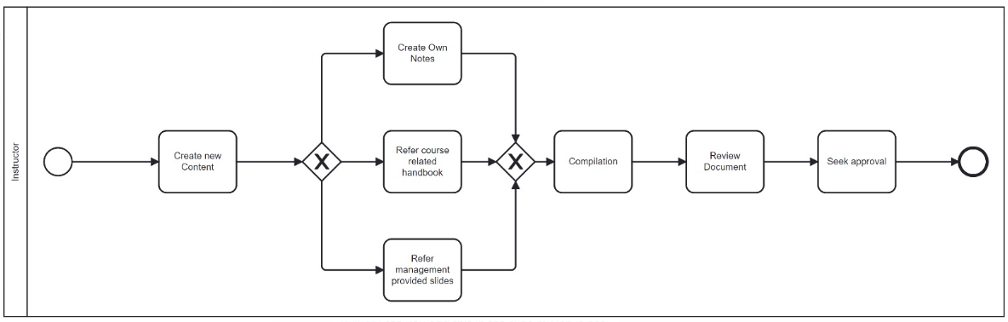
CREATE CONTENT

Slide 6
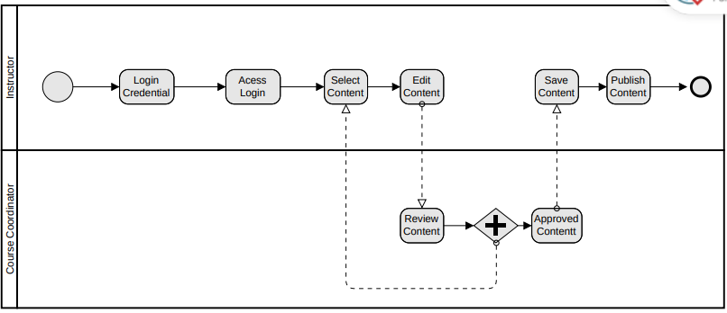
EDIT CONTENT

Slide 7
DELETE CONTENT

